Slide 1
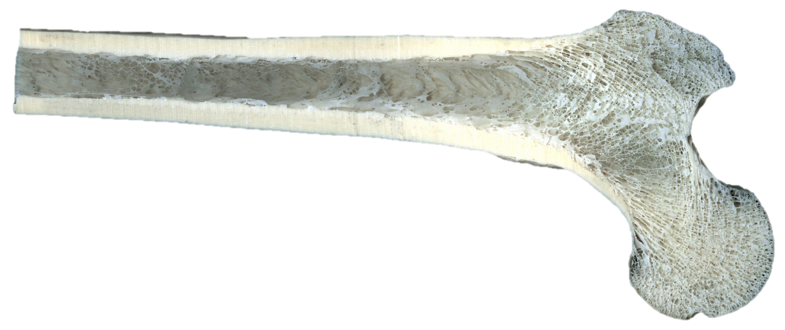
Daily Review
Vocabulary
Porous: has many holes
Structure of Bones
There are two types of bone tissue:
Compact bone is dense and heavy, for strength.
Spongy bone is porous, which makes it light.
Think, pair, share: How is spongy bone different to compact bone in terms of its structure?
Think, pair, share: How is spongy bone different to compact bone in terms of its function?

Slide 2
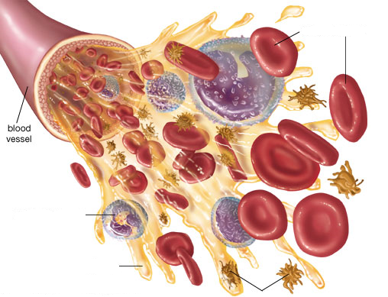
Daily Review
Components of Blood
Blood has four different components.
Think, Pair, Share: list the four components of blood.

Slide 3
Daily Review
Components of Blood
On your whiteboard, match the following blood components to the corresponding letter on the diagram.
Match the function of the blood components below.
1 Clots blood
2 Fights diseases
3 Carries oxygen
4 Carries nutrients, wastes, hormones
A
B
C
D

Slide 4
Daily Review
blood from the body
blood from the lungs
The Heart Contracts and Relaxes
The heart beat begins when the heart muscles relax and blood flows into the atria.
The atria then contract and the valves open to allow blood into the ventricles.
Think, pair, share: What happens next? Which part of the heart contracts, and where is the blood sent?

Slide 5
Daily Review
Double Pump System
The circulatory system is a double pump system.
It is called this because there are two separate circuits through which the blood flows.
The right side deals with deoxygenated blood.
The left side deals with oxygenated blood.
Think, pair, share: Why is the circulatory system referred to as a double pump system?
Think, pair, share: How are the two sides of the pump system different?
Lungs
Body cells

Slide 6
Factors Affecting Circulation and Heart Rate Year 8 Science

Slide 7
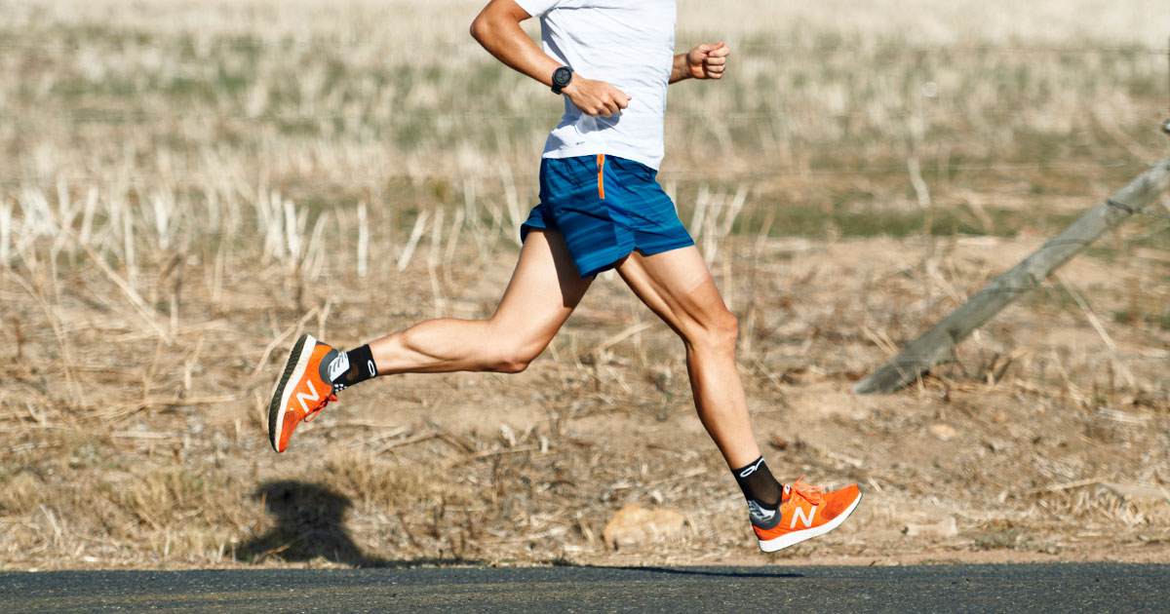
Learning Objectives
CFU
What are we going to learn?
Identify factors affecting circulation.
Plan an experiment to investigate one of those factors.
Activate Prior Knowledge
Think, Pair, Share: What happens to your heart rate (pulse) when you participate in a physical activity (e.g. running)?
What happens to your pulse when you do a different type of exercise, or you exercise for longer?

Slide 8
Concept Development
CFU 1
What is the function of the blood in the circulatory system?
CFU 2
How is the blood travelling through the body, and to individual cells?
Blood and Circulation
All the cells in your body need oxygen and nutrients in order to function.
Blood carries the oxygen and nutrients to individual cells through the blood vessels.
As the cells use oxygen and nutrients for energy, they are producing waste products.
These waste products are carried away from the cells in the blood.
CFU 3
Think, Pair, Share: What are some substances carried in the blood to cells?
CFU 4
Think, Pair, Share: What is carried away from cells?

Slide 9
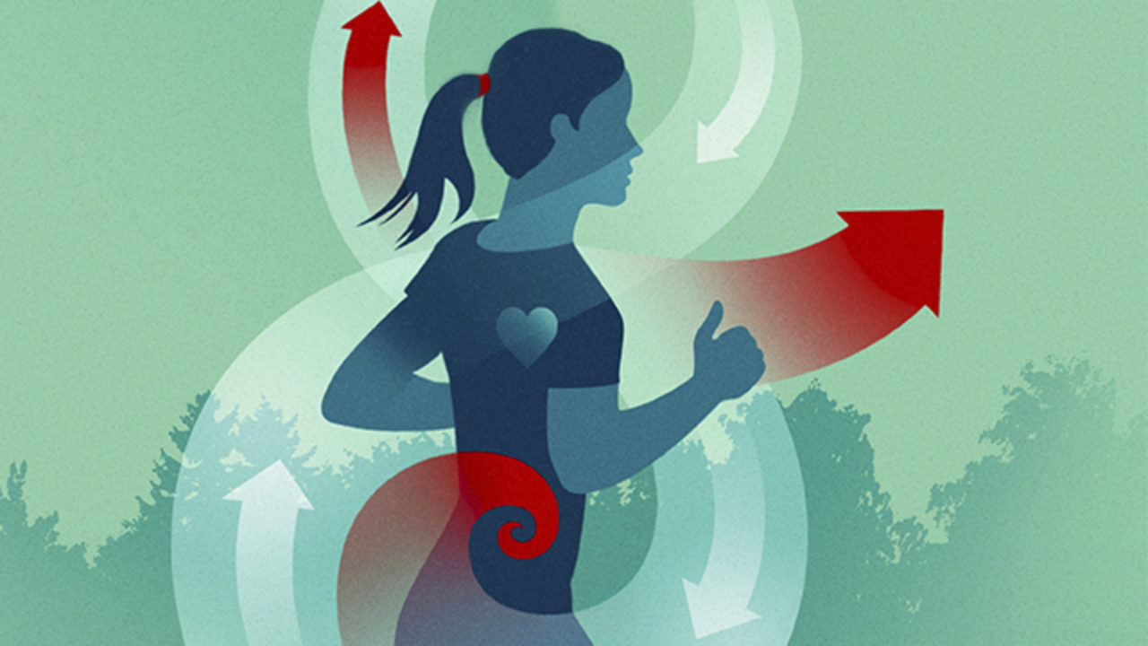
Concept Development
CFU 1
What happens in your cells when you start to exercise?
CFU 2
Why does your heart need to beat more frequently?
Circulation and Exercise
When you begin to exercise, your cells use more energy and oxygen, and produce more waste products.
This means your blood needs to move faster through your body to keep a constant supply of nutrients, and remove the wastes.
To make the blood circulate faster, your heart needs to beat more frequently.
You can detect this change in heart rate through your pulse.
CFU 3
How are you able to detect a change in your heart rate?

Slide 10
Skill Development / Guided Practice
You are now going to plan an investigation to test how your heart rate is affected by the duration of exercise.
You will be required to write and hand in a report on your investigation, which will be assessed.
You may plan your investigation and write your report on your device or on paper.
Download the Investigation Planning Sheet from Connect or collect a hard copy now.

Slide 11
Skill Development / Guided Practice
You are now going to plan an investigation to test how your heart rate is affected by the duration of exercise.
You are going to conduct an experiment as described below. Pay close attention so that you can write an accurate method for your experiment later on.
Measure and record your resting heart rate by counting your pulse for 30 seconds and multiplying your count by 2.
Do an exercise of your choice (e.g. running on the spot, doing star jumps) for 30 seconds, then measure and record your heart rate again.
Stop exercising for a few minutes while your heart rate returns to its resting level.
Repeat steps 2 and 3 at least 4 more times, exercising for 30 seconds longer each time.

Slide 12
Skill Development / Guided Practice
Writing your aim
An aim is a statement of what are you trying to find out in an experiment.
Aims usually start with the word ‘To’; for example:
To find out if…
To discover how…
To investigate the…
On your whiteboards, write an aim for this investigation.
Before you continue, you need to choose the type of exercise you will do.
Measure resting heart rate
0:30 exercise
Rest
1:00 exercise
Rest
1:30 exercise
Rest
2:00 exercise…

Slide 13
Skill Development / Guided Practice
Identifying the variables
You need to think about how to make your investigation a fair test.
Identify the variables in your investigation:
Independent variable (what you are changing)
Dependent variable (what you are measuring/observing)
Controlled variables (what you need to keep the same) – at least 3
Measure resting heart rate
0:30 exercise
Rest
1:00 exercise
Rest
1:30 exercise
Rest
2:00 exercise…

Slide 14
Skill Development / Guided Practice
Writing your hypothesis
A hypothesis is a testable statement describing what you are trying to prove with your experiment.
Your hypothesis is written like a statement of fact, but may or may not be supported by your results.
Do not use the word “I” (e.g. “I predict”, “I think”, “I believe”).
Do not use the word “will” (e.g. “this will happen”) – you are not writing a prediction.
On your whiteboards, write a hypothesis for this experiment.
Measure resting heart rate
0:30 exercise
Rest
1:00 exercise
Rest
1:30 exercise
Rest
2:00 exercise…

Slide 15
Skill Development / Guided Practice
List of Equipment
Make a list of all the equipment you will need to use in your investigation.
Method
Write a method by which you can change one variable and measure its effect on the other.
Be specific with the steps in your method. It’s similar to writing a recipe.
Do not refer to a person/people in your method.
Results
Construct a table so that you can record the changes in the variables.
Measure resting heart rate
0:30 exercise
Rest
1:00 exercise
Rest
1:30 exercise
Rest
2:00 exercise…

